Slide 1
Getting to Know Your Data

Slide 2
Data Objects and Attribute Types

Slide 3
Data Objects
Data sets are comprised of data objects
Typically a data object is an entity (a row or record in your “table” of data)
Also called samples, examples, instances, datapoints, objects, tuples
Data objects are described by attributes
Database rows → data objects → columns (attributes)

Slide 4
Attributes
Attributes (AKA dimensions, features, variables) are data fields that represent a characteristic or feature of a data object
E.g., ENumber, Name, Address
Attributes can be represented by a certain type of data
Nominal
Ordinal
Binary
Numeric: quantitative
Interval-scaled
Ratio-scaled

Slide 5
Attribute Types
Nominal: categories, states, or labels / names
Hair_Color = { Auburn, Black, Blond, Brown, Grey, Red, White }
Marital Status, Occupation, ID Numbers, Zip Codes
Binary: Nominal attribute with only 2 states (0 and 1)
Symmetric binary: both outcomes are equally important (e.g., heads/tails)
Asymmetric binary: outcomes are not equally important (e.g., medical test → positive vs negative)
Convention is to assign 1 to most important outcome (e.g., HIV positive)
Ordinal
Values have a meaningful order (ranking) but magnitude between successive values is not known
Size = { small, medium, large }, grades, army rankings

Slide 6
Numeric Attribute Types
Interval-Scaled
Measured on a scale of equal-sized units
Values have order
E.g., temperature in Celsius or Fahrenheit, calendar dates
No true zero-point
Ratio-Scaled
Inherent zero-point
Values are an order of magnitude larger than the unit of measurement (10 awards is twice as many as 5 awards)
E.g., temperature in Kelvin, length, height, weight, monetary quantities

Slide 7
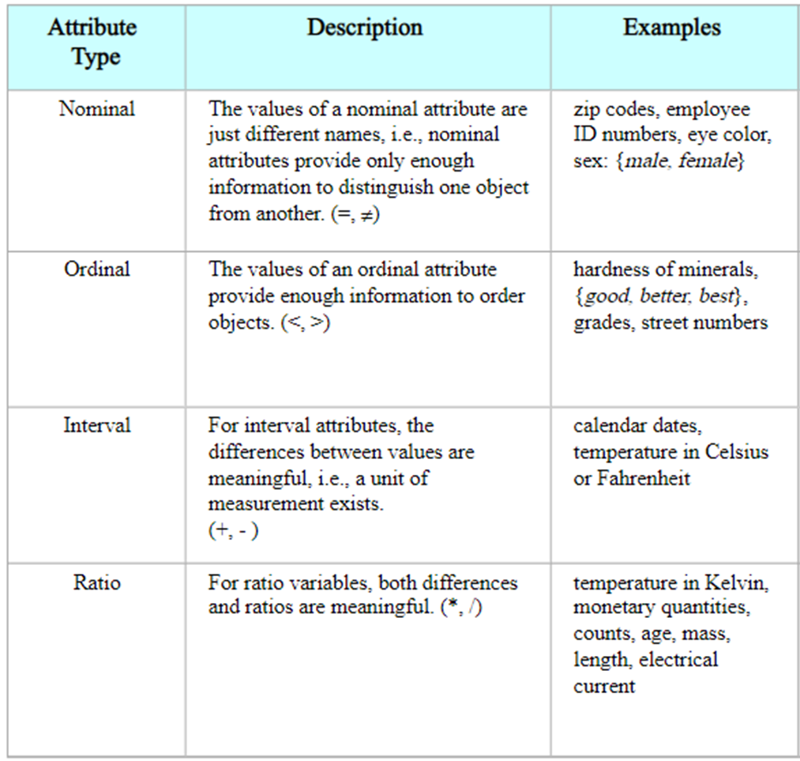

Slide 8
Discrete vs. Continuous
Discrete
Finite or countably infinite set of values
E.g., Zip codes, profession, customer_id, or the number of words in a document
Sometimes represented as integer values
Note: Binary attributes are a special case of discrete attributes
Continuous
Has real numbers as attribute values
E.g., Temperature, height, or weight
In practicality, real values can only be measured and represented using a finite number of digits
Typically represented as a floating-point variable
E.g., 5.5, 0.0001, -2,345.6789

Slide 9
Not Every Float Number is Continuous
A shoe size (e.g., { 9, 9.5, 10, 10.5, etc.}) is not continuous
There is no such shoe size as 9.102 or 10.789
You can put shoe sizes in a dropdown list. It is not practical, however to put the exact value weight (a continuous value) in a dropdown list (e.g., 142.459201 lbs.)

Slide 10
Basic Statistical Descriptions of Data

Slide 11
Basic Statistical Descriptions of Data
Motivation: to better understand the data → central tendency, variation, and spread
Data dispersion characteristics: median, max, min, quantiles, outliers, variance, etc.
Numerical dimensions correspond to sorted intervals
Data dispersion: analyzed with multiple granularities of precision
Boxplot or quantile analysis on computed measures
Dispersion analysis on computed measures
Folding measures into numerical dimensions
Boxplot or quantile analysis on the transformed cube

Slide 12
Measuring the Central Tendency
Mean (algebraic measure)
Sum of values, divide by total number of values
Median
Middle value if odd number of values, or average of the middle two values otherwise
Mode
Value that occurs most frequently in the data

Slide 13
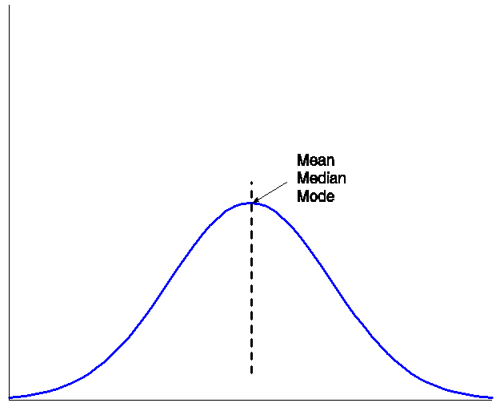
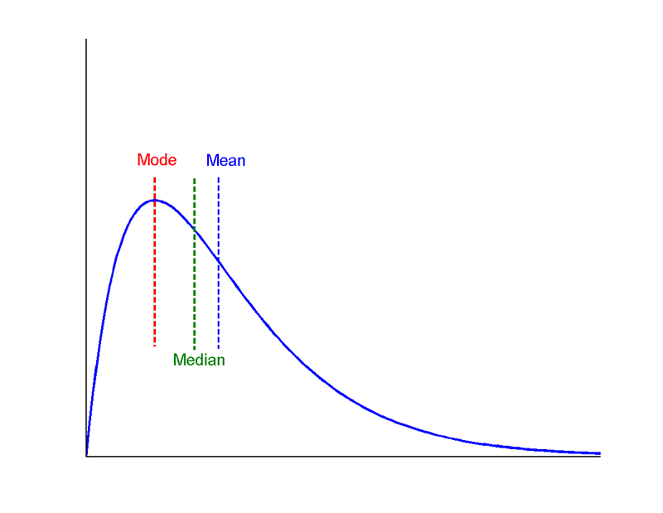
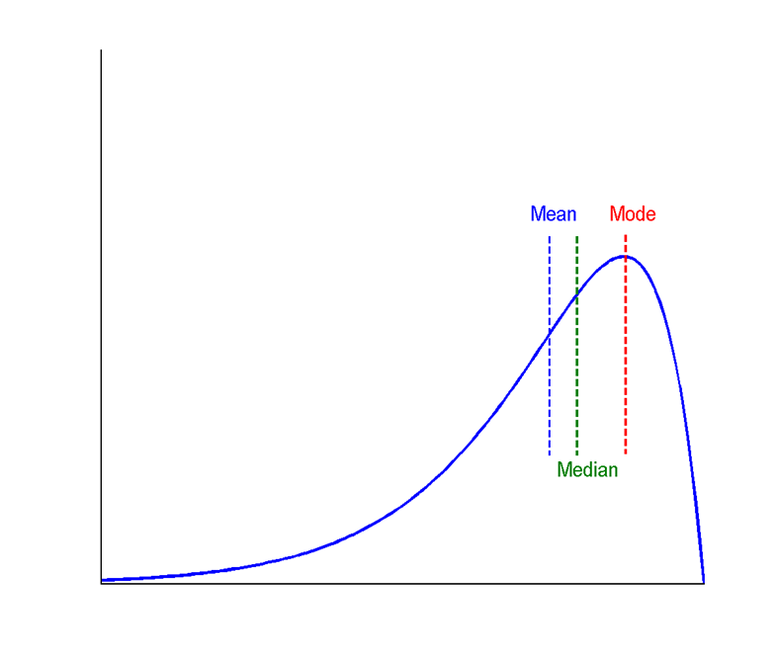

Slide 14
Measuring Data Dispersion
Quartiles, outliers, and boxplots
Quartiles: Q1 (25%), Median/Q2 (50%), Q3 (75%)
Interquartile range: IQR = Q3 - Q1
Five number summary: min, Q1, median, Q3, max
Boxplot: ends of the box are the quartiles, median is marked, add whiskers and plot outliers individually
Outlier: usually a value higher/lower than 1.5 * IQR
Variance and Standard deviation
Standard deviation measures how spread apart our data is
Small standard deviation means less spread out data
High standard deviation means more spread out distribution
Variance = (standard deviation)²

